Slide 1

Gauchers Disease
By: Ridley, S.
For: Dr. Halloran: Cell Physiology

Slide 2
OUTLINE
Word Bank
Definition of Gauchers Disease
History of GD
Chemical Cause
Symptoms
Types of Gauchers Disease
Who Can Get Gauchers Disease
How To Get Tested
Gene Mutation
Clinical Treatments
Resources

Slide 3
Word Bank
Anemia: A decrease in Red Blood cells
G: Mutated Gene
g: Normal gene
Glucocerebrosidase: an enzyme of mammalian tissue that catalyzes the hydrolysis of the glucose part of a glucocerebroside and is deficient in patients affected with Gaucher's disease
Hepatosplenomagaly: Enlarged Liver and Spleen
Leukopenia: Is a decrease in white blood cells.
Platelets(Thrombocytes): Colorless blood cells that help blood to clot.
Thrombocytopenia: Condition in which individual have a low blood platelet count; often occurs as a result of a spate disorder, such as leukemia or an immune system problem, i.e. Gauchers Disease.

Slide 4
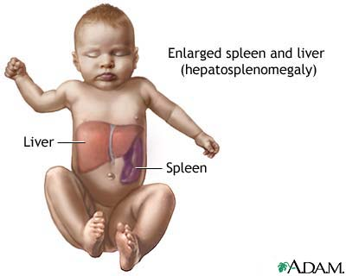
A genetic metabolic disorder in which a fatty substance accumulates in the body, especially the spleen, liver, lungs, and bone marrow.
Definition:

Slide 5
History of Gauchers Disease
It is also the most common genetic disease affecting Ashkenazi Jewish people (Eastern, Central and Northern European ancestry), with a carrier frequency of 1 in 10 (Dr. John Barranger and Dr. Ed Ginns 1989). This pan ethnic disease involves many organ systems, such as liver, spleen, lungs, brain, metabolism and bone marrow.

Slide 6
History of Gauchers Disease
In 1960, an experiment by Dr. Roscoe Brady , showed that people with Gauchers disease made lipids normally but did not make enough of the enzyme Glucocerebrosidase found in the white blood cells.

Slide 7
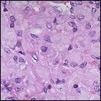
Chemical Cause
In 1934, the French chemist A. Aghion discovered the chemical cause of the enlarged spleens and liver: a buildup of a lipid (fatty substance) called "glucocerebroside."
To the right: Enlarged Cells in the Spleen of someone with Gauchers disease

Slide 8
The disorder is characterized by bruising, fatigue, anemia, low blood platelets, and enlargement of the liver and spleen.
Symptoms:

Slide 9
Types of Gauchers Disease
Activity of the enzyme Glucocerebrosidase, help researchers identify the three Types of Gauchers disease Type 1, Type II, and Type III

Slide 10
TYPE I
The most common type of GD, often presents with abdominal pain and/or enlargement due to hepatosplenomegaly( enlarged liver and spleen) as well as a combination of anemia(decrease in red blood cells), leukocytopenia (, and thrombocytopenia as the most common clinical manifestations.

Slide 11
TYPE 1:
Young/ Adults and Adults
No nervous system complication
Effects of the disease varies from mild to severe
Glucocerebrosidase activity is less than normal

Slide 12
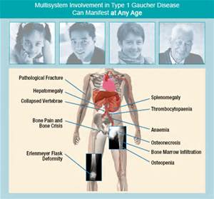
TYPE 1:

Slide 13
TYPE II
Infants
Early Nervous System Complications
Death infancy
Glucocerebrosidase is active but very minimal

Slide 14
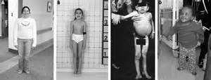

Slide 15
TYPE III
Children/Young Adults
Delayed onset of Nervous System complications
Effects of disease because severe once it manifest
Glucocerebrosidase activity is minimal

Slide 16
Who Can Get Gauchers Disease
1986, Dr. Philippe Gaucher first described, the symptoms now known as Gaucher Disease as the following:

Slide 17
Who Can get Gauchers Disease Cont’d
It is an autosomal recessive disease and the most prevalent Lysosomal Storage Disorder (LSD), with an incidence of about 1 in 20,000 live births.
Despite the fact that Gaucher Disease consists of a phenotype, with varying degrees of severity, it has been sub-divided in three subtypes according to the presence or absence of neurological involvement

Slide 18
Who Can Get Gauchers Disease Cont’d
Gaucher disease is an "autosomal recessive" genetic disease.
This means that both of the glucocerebrosdiase genes a person inherits - one from the mother and one from the father -- must be mutated for the person to have the disease.
A person with only one mutated gene is a carrier.
A carrier of Gaucher Disease is not affected but can pass the trait on to his/her children.

Slide 19
How To Get Tested For Gauchers Disease
Blood Test
Saliva Test
Getting tested will help to identify potential carriers of the Gaucher gene.
Gaucher disease can be diagnosed early through a blood test.

Slide 20
Gene Mutation of Gauchers Disease
In 1987, when the first gene mutation that causes Gaucher disease was discovered by Dr. Shoji Tsuji and coworkers
Dr. Tsuji developed an inheritance diagram to illustrate three different paring of how a child can be affected depending on the genetic material he/she inherits from his/her parents.

Slide 21
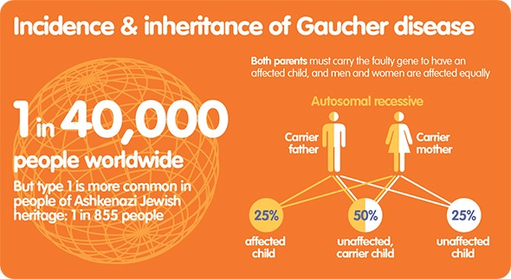

Slide 22
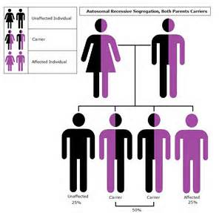

Slide 23
Gene Mutation Inheritance Diagram Option 1
Parent 1 (a carrier) G(Mutated Gene) g (Normal Gene)
Parent 2 (a carrier) Gg
Possibilities for each child they have
GG two mutated genes; person with Gaucher disease
Gg carrier of Gaucher gene; no signs or symptoms
gG carrier of Gaucher gene; no signs or symptoms
gg two normal genes; normal enzyme activity, not a carrier

Slide 24
Gene Mutation Inheritance Diagram Option 02
Parent 1(a person with Gaucher disease) GG
Parent 2(a person with normal genes)gg
Possibilities for each child they have
GG carrier of Gaucher gene; no signs or symptoms
Gg carrier of Gaucher gene; no signs or symptoms
gG carrier of Gaucher gene; no signs or symptoms
Gg carrier of Gaucher gene; no signs or symptoms

Slide 25
Gene Mutation Inheritance Diagram Option 03
Parent 1 (a person carrier) Gg
Parent 2 (a person with normal genes) gg
Possibilities for each child they have
GG two mutated genes; person with Gaucher disease
Gg carrier of Gaucher gene; no signs or symptoms
gG carrier of Gaucher gene; no signs or symptoms
gg two normal genes; normal enzyme activity, not a carrier

Slide 26
CLINICAL TREATMENTS:
Enzyme replacement therapy (ERT)
An ERT is a type of medical treatment where a person receives an enzyme that his or her body does not produce enough of, usually by an intravenous—inside a person’s vein—infusion.
ELELYSO
ELELYSO acts like the enzyme glucocerebrosidase .
This enzyme does not work well in people with Gaucher disease. ELELYSO enters Gaucher cells, where it breaks up the fatty substance that has built up, reducing the size of the cells.
ELELYSO is supplied as 200 Units per vial and is available by prescription only

Slide 27
RESOURES:
Gauchers Disease:
RETRIEVED FROM WORLD WIDE WEB APRIL 27, 2015
http://history.nih.gov/exhibits/gaucher/docs/page_03.html
Mingyi Chen and Jun Wang (2008) Gaucher Disease: Review of the Literature. Archives of Pathology & Laboratory Medicine: May 2008, Vol. 132, No. 5, pp. 851-853. http://www.archivesofpathology.org/na101/home/literatum/publisher/pinnacle/journals/content/
How do you get Gaucher Disease?
http://www.elelyso.com/how-do-you-get-gaucher?

Slide 28
RESOURCES:
Images of Gauchers Disease http://www.bing.com/images/search?q=gauchers+disease

